Slide 1

Name : j.viswanath
Reg.no. : 192111435
Department : cse
Subject : software tetsing
for test case design
Course code : CSA3723
Topic : e-tax filing
Faculty : Gururama senthil.p

Slide 2


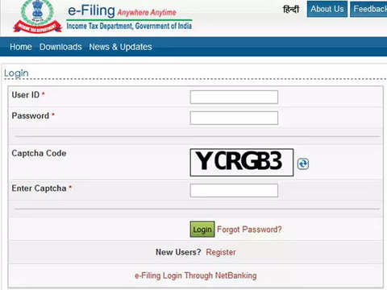
E-TAX FILING
(E-GOVERNANCE)

Slide 3
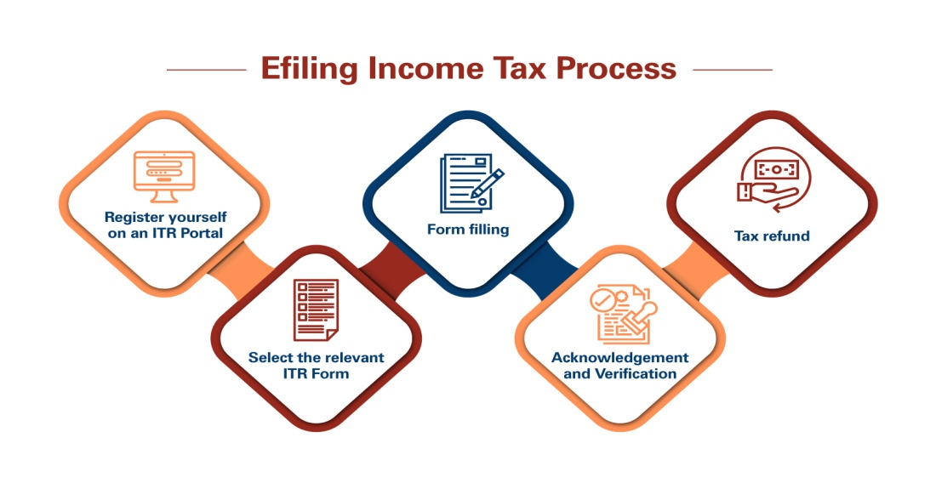
AIM: To verify and analysis the e-tax filing website working properly or not
REQUIREMENTS:
Login
PAN card number
User basic details
Verifying details
Secure account

Slide 4
TEST SCENARIO login using Aadhaar info
Step-1: Go to the e-Filing portal homepage and click Login.
Step-2: Enter your aadhaar in the Enter your User ID textbox and click Continue.
Step-3:Select OTP on mobile registered with aadhaar after confirming your Secure Access Message and click Continue. In case of using aadhaar OTP as a higher security option, login with your user ID and password and on the Higher Security Options page, click OTP on mobile number registered with Aadhaar > Continue.
Step-4: If you already have OTP, select I already have OTP on mobile number registered with aadhaar and go to Step 6. If valid OTP is not available, click Generate OTP.
Step-5: On the Verify, it's you page, click I Agree to validate my Aadhaar Details > Generate Aadhaar OTP.
Step-6: Enter your 6-digit OTP received on your mobile number registered with Aadhaar and click Login.
Post successful validation, you will be taken to the e-Filing Dashboard.

Slide 5
TEST SCENRIO (REGISTERING AN ACCOUNT)
STEP-1: Visit the ‘e-Filing’ Portal https://www.incometax.gov.in/iec/foportal/
STEP-2: Click ‘Register Yourself' button located at right side of the Home Page
STEP-3:Select the user type as ‘Individual’. Click Continue
STEP-4:Provide the following basic details:
PAN
Surname, First Name and Middle Name
Date of birth
Residential Status and click continue
STEP-5: Fill in the following mandatory details:
Password Details
Contact Details
Current Address
Click ‘Submit’
STEP-6: After registration,
*For Residents, a six digit OTP1 and OTP2 will be shared on your mobile number and email ID, specified at the time of registration. *For Non-residents, OTP will be shared on your primary email ID, specified at the time of registration.
STEP-7: Enter the correct OTP to complete the registration process

Slide 6
Login-test case scenario
Positive test cases
Negative test cases
To verify user is enter with a valid user id
Verify If no user id register should be there
To check the auto fill is working or not
To verify switching input boxes using tabs
To verify the login button is entering with enter button in system
To check log out option
To verify user can’t be entered with a invalid user id
To verify not having of register option
To verify Log in with empty required fields.
To verify Login with an unregistered user id

Slide 7
Register-test case scenario
Positive test cases
Negative test cases
To verify Click on Radio buttons, buttons and dropdowns
To verify register is option is available
To verify user should validate and continue with valid PAN card number
To verify continue option is working when u give tax payer option
To verify all fields must be filled
To verify all user basic details must be as per PAN card
To verify account is secured
To verify register option is not working
To verify user can’t login or validate with invalid PAN card number
To verify all field or any one is empty
To verify user not entering last name and basic details as per PAN in basic section
To verify account is not secured

